Slide 1
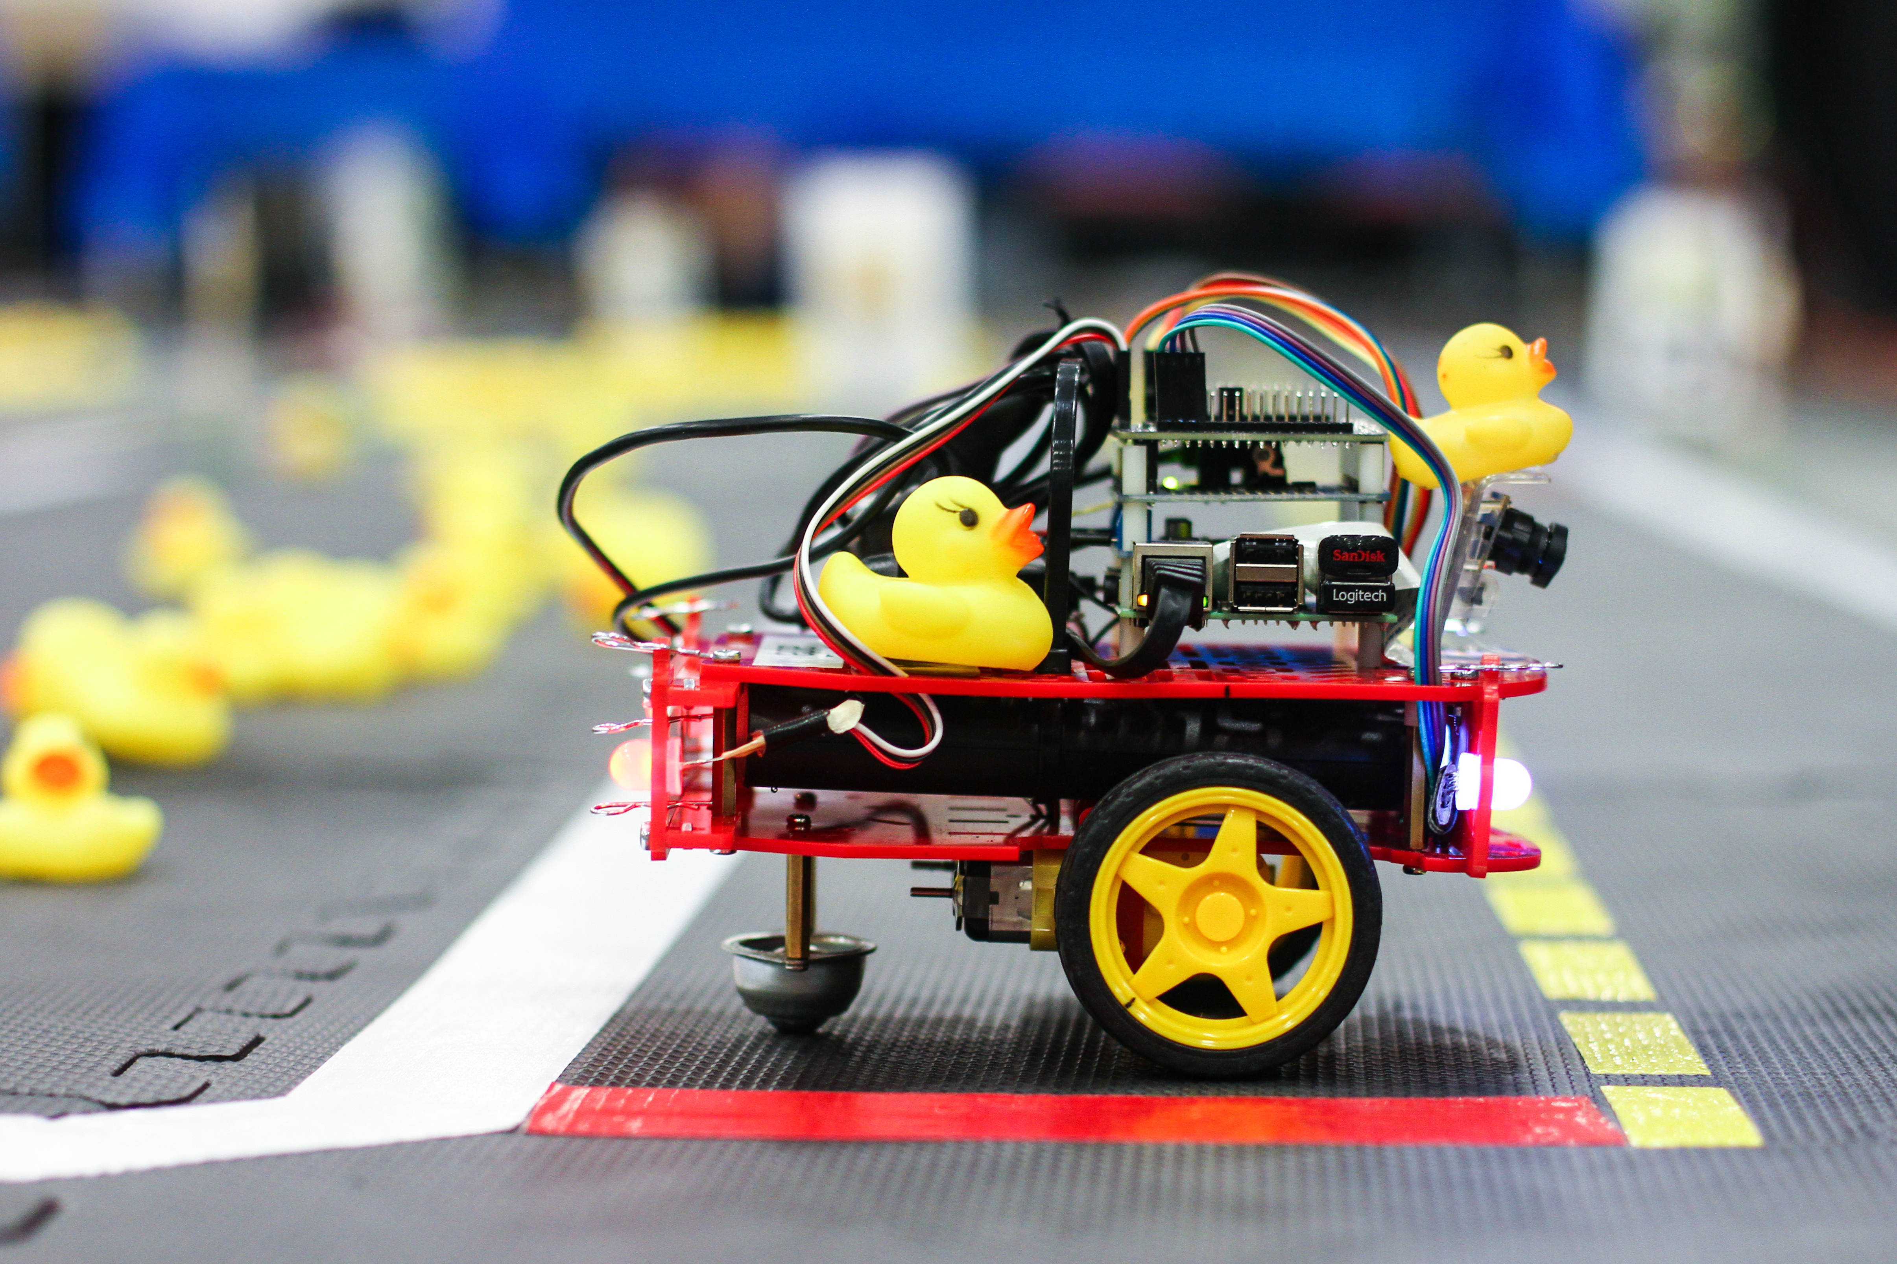
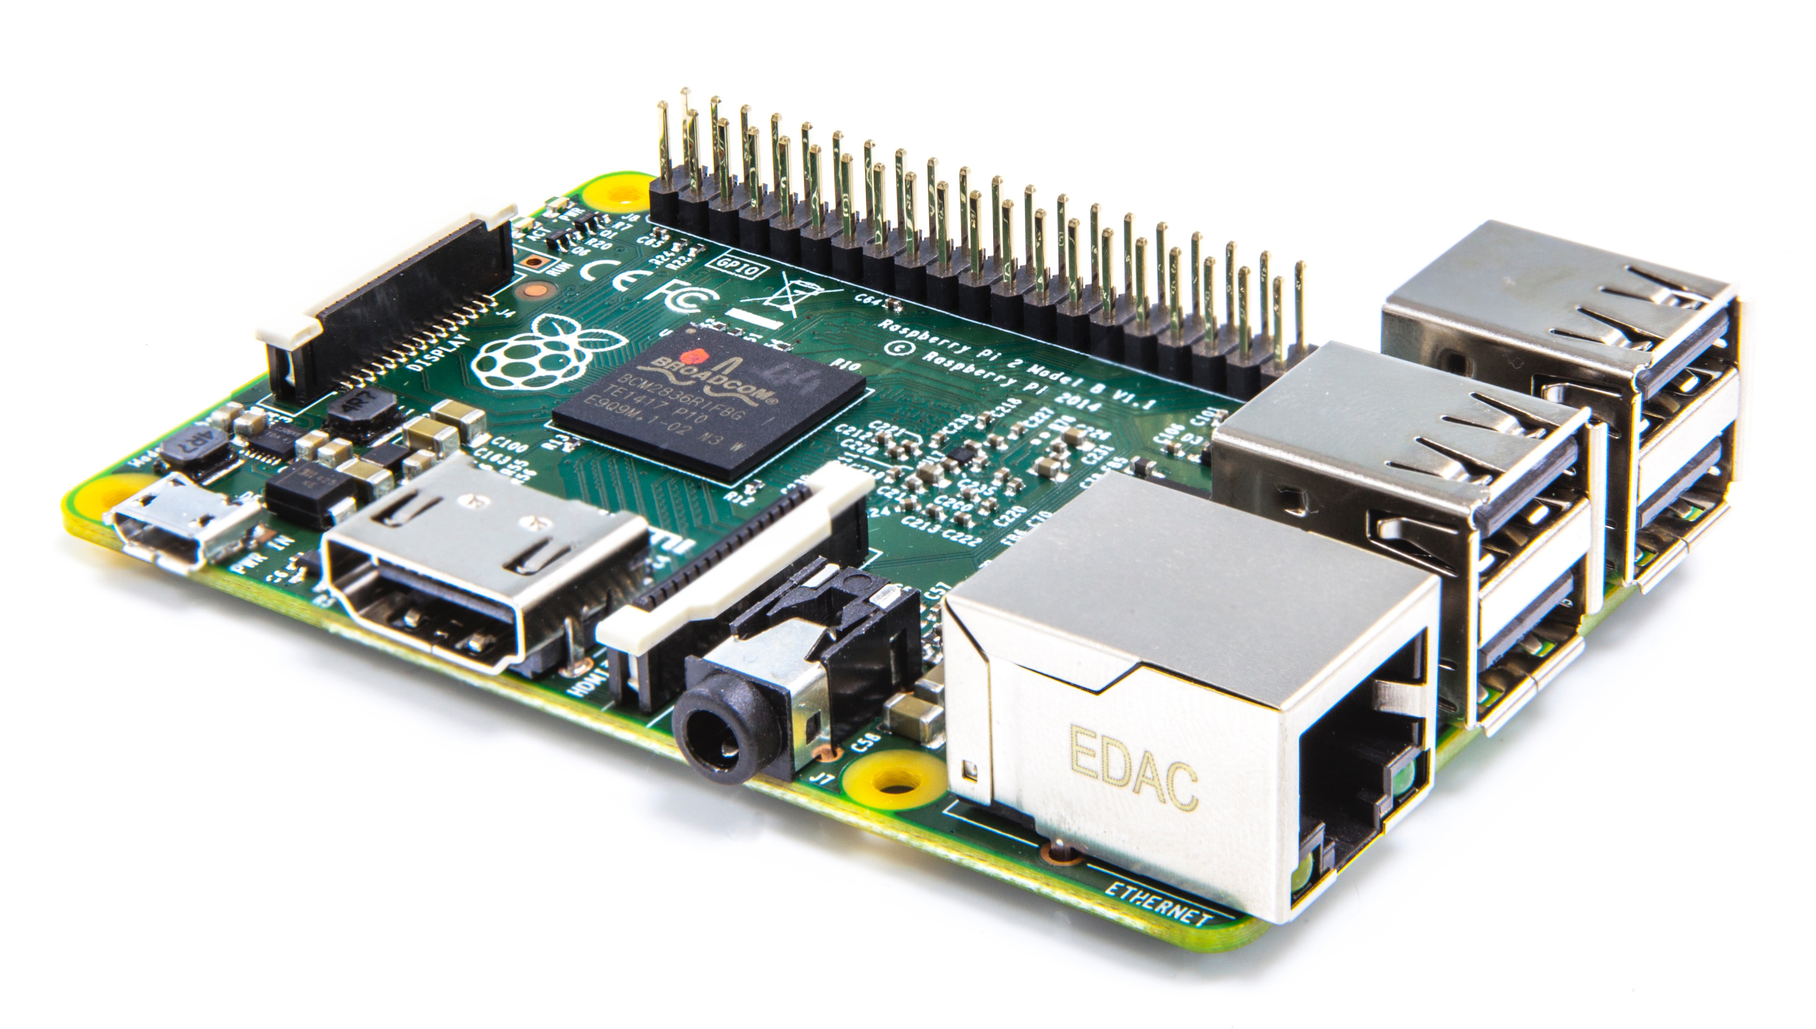
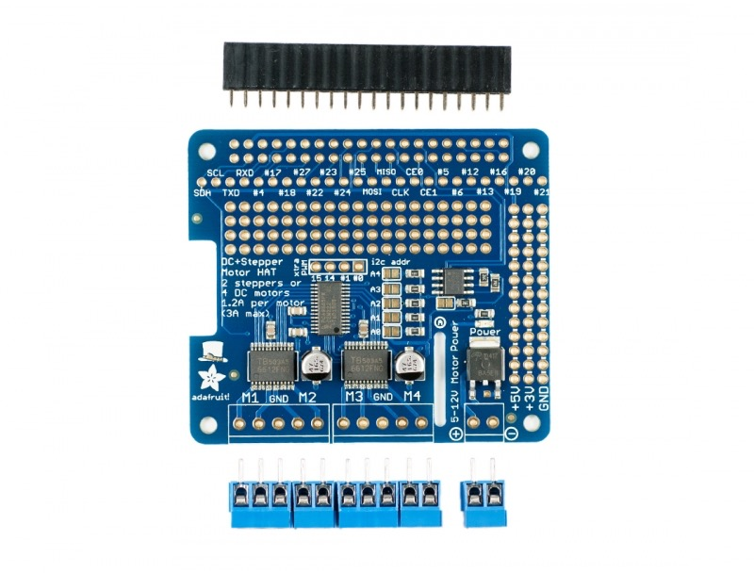

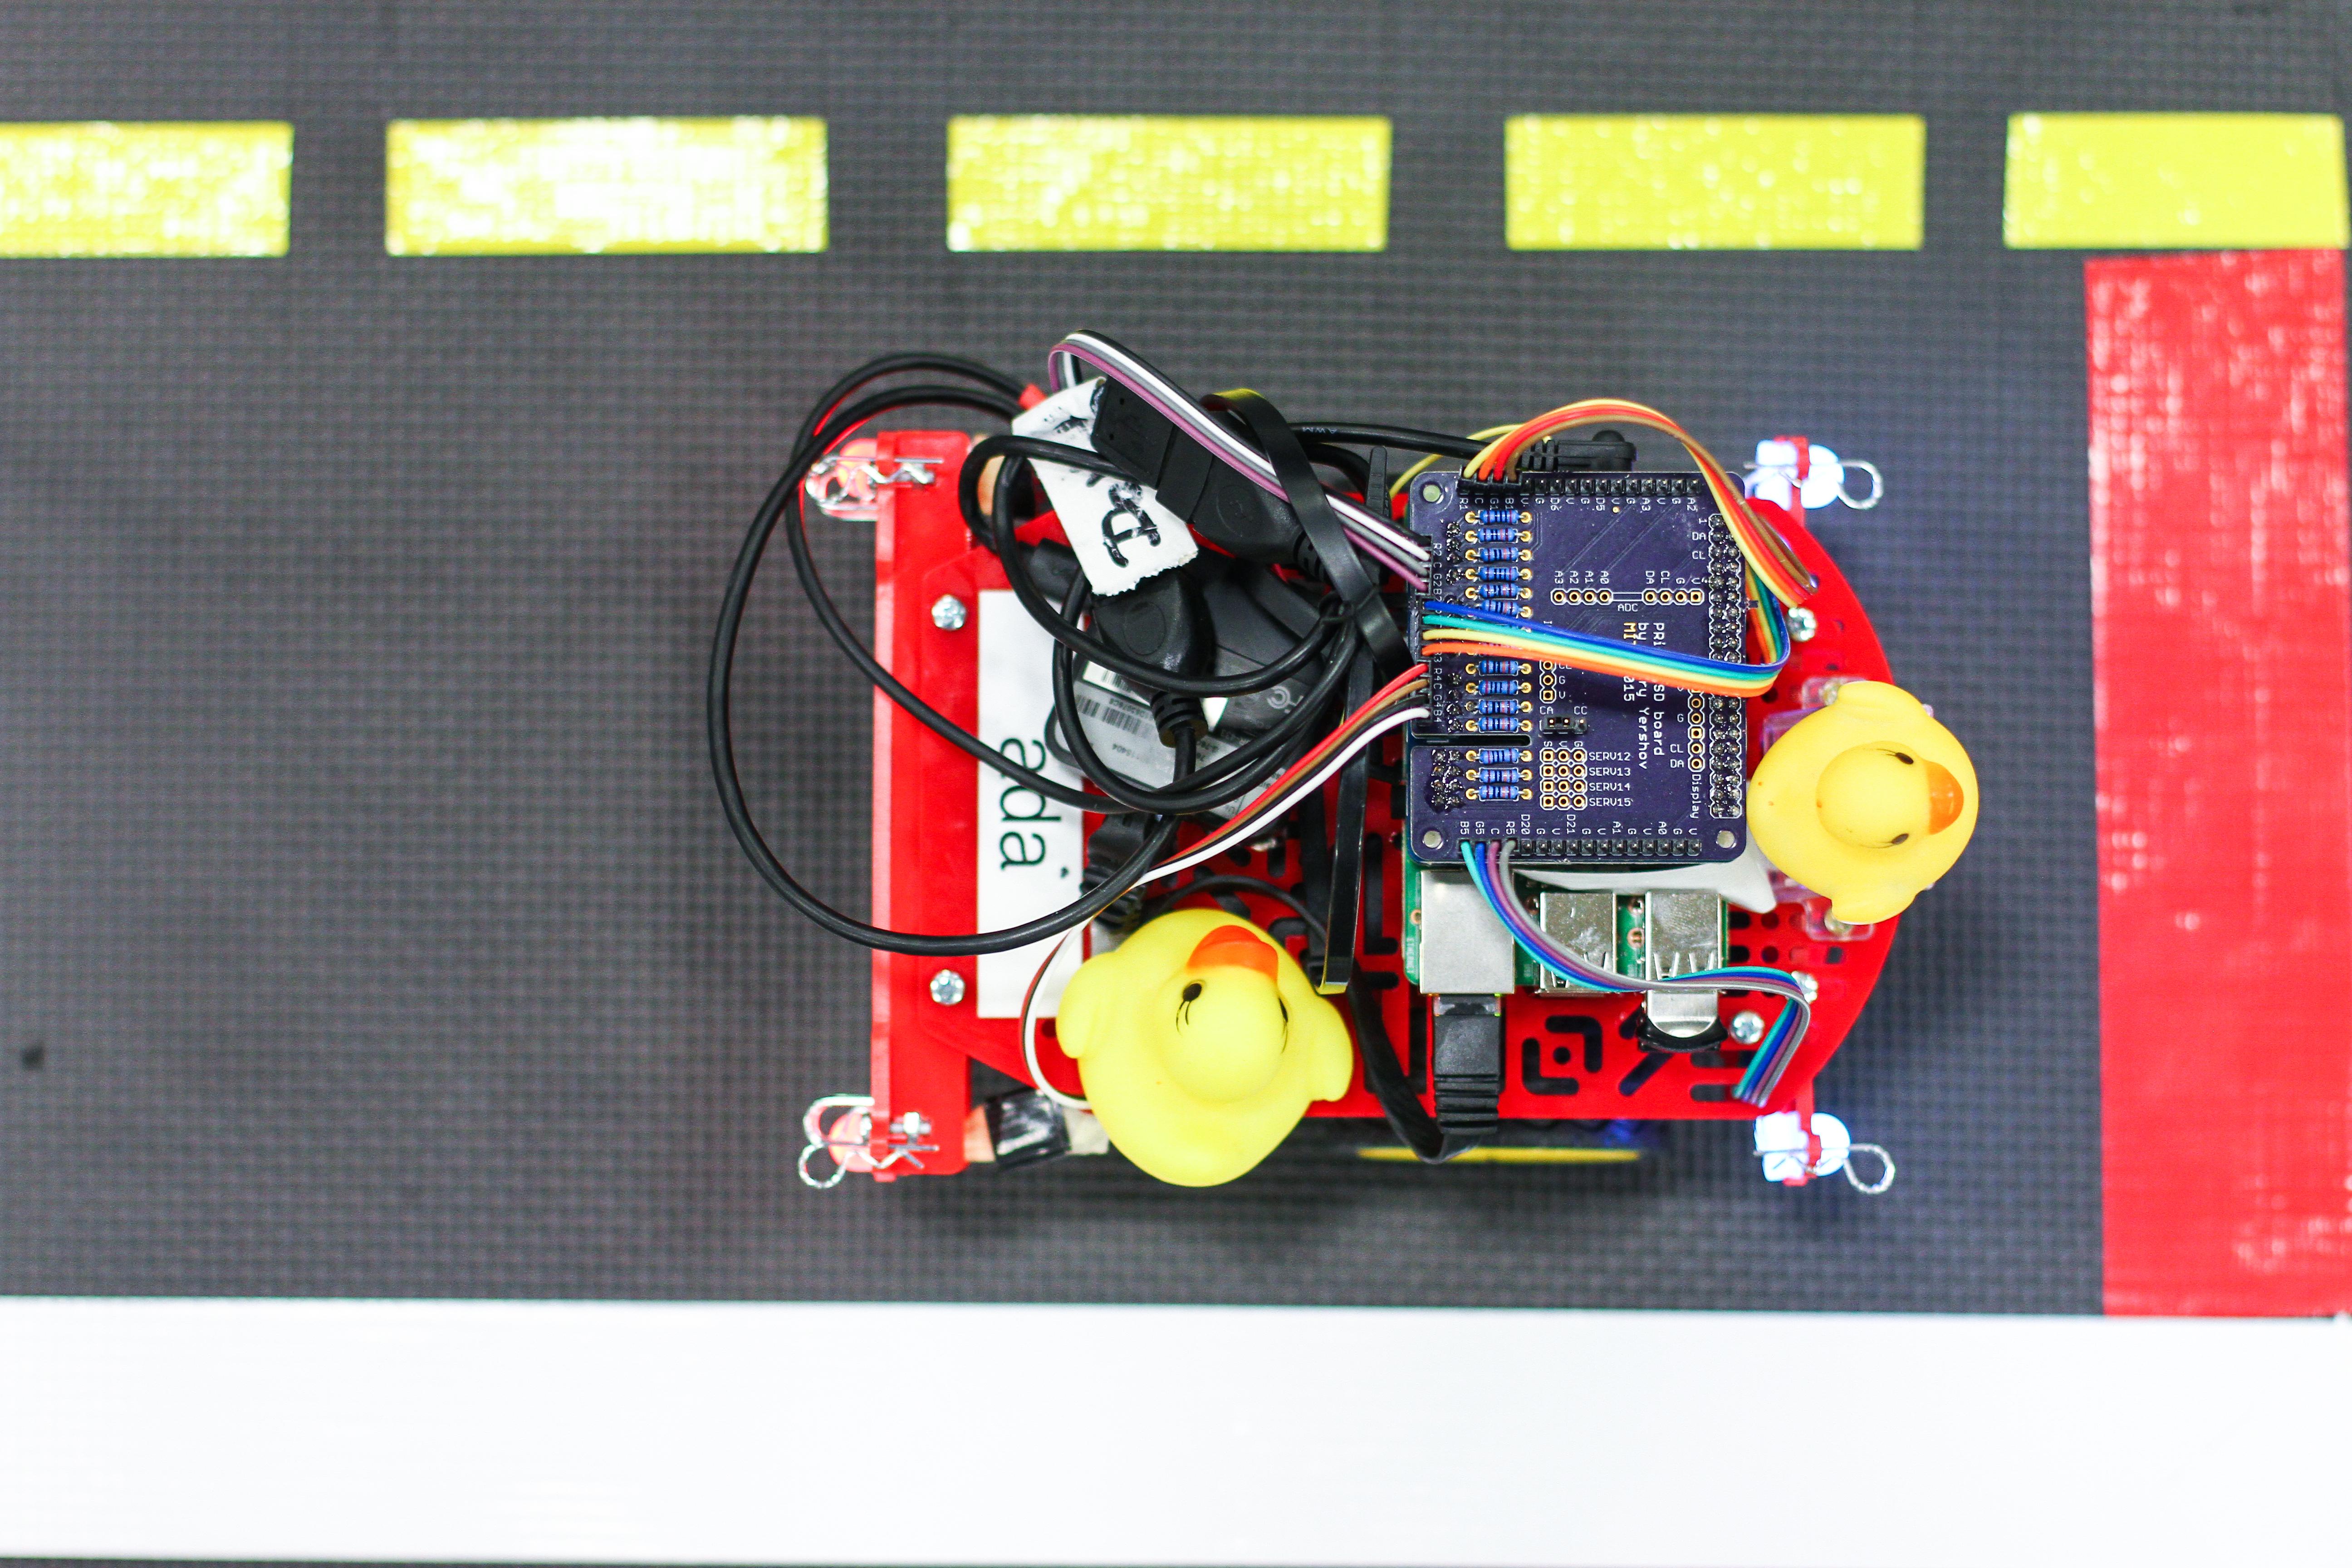
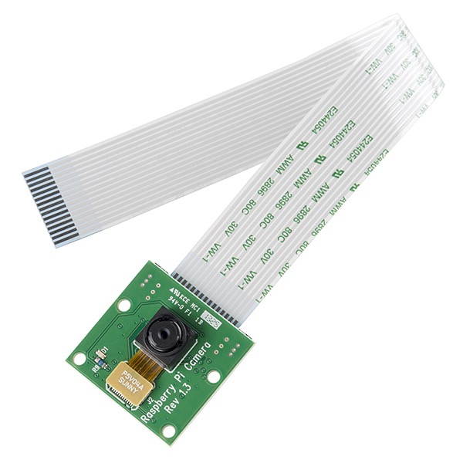
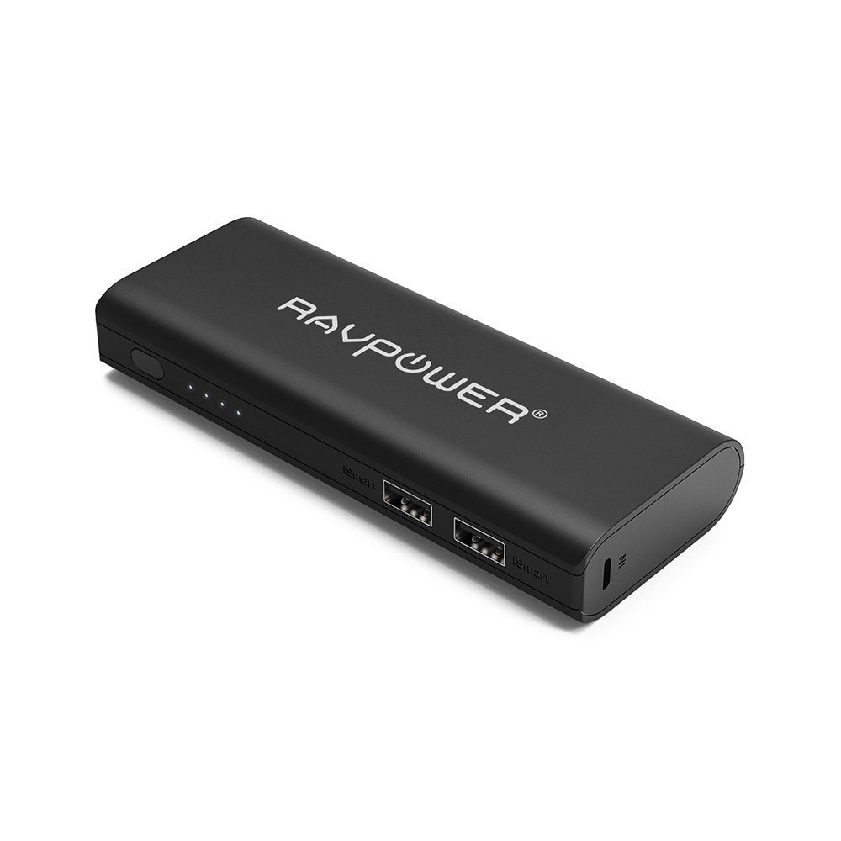
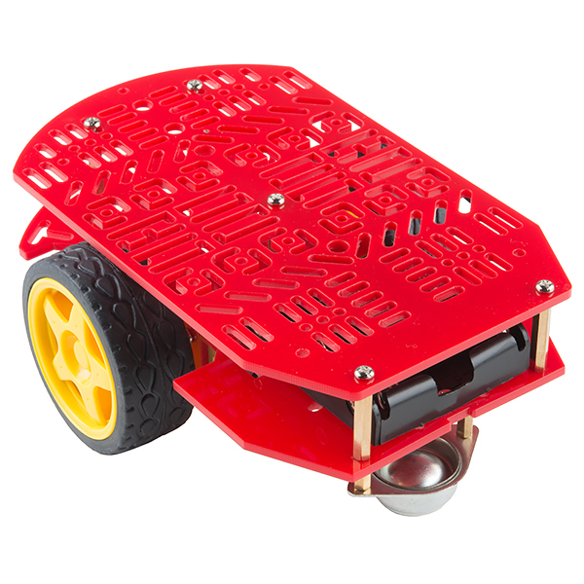
Duckiebots
Raspberry PI
DC Motor Shield
Duckie
$35
3/$1
$22
Camera
Battery
Chassis
$12
$22
$15
Fancier configuration (for research): PWM shield ($15), RGB LEDs ($10), onboard access point ($40).

Slide 2
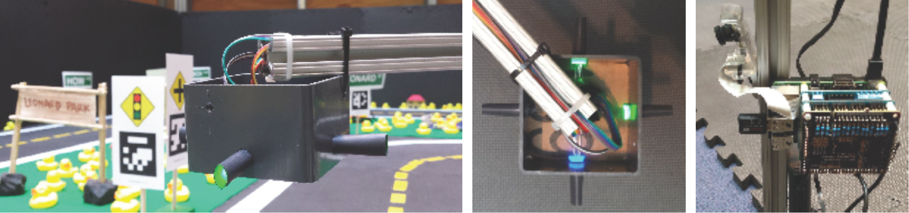


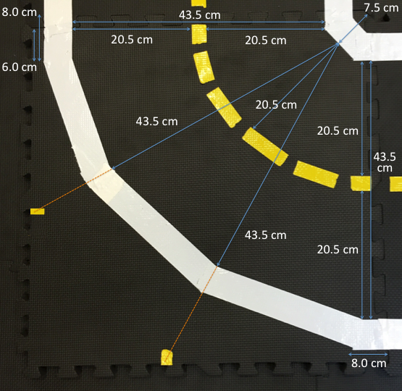


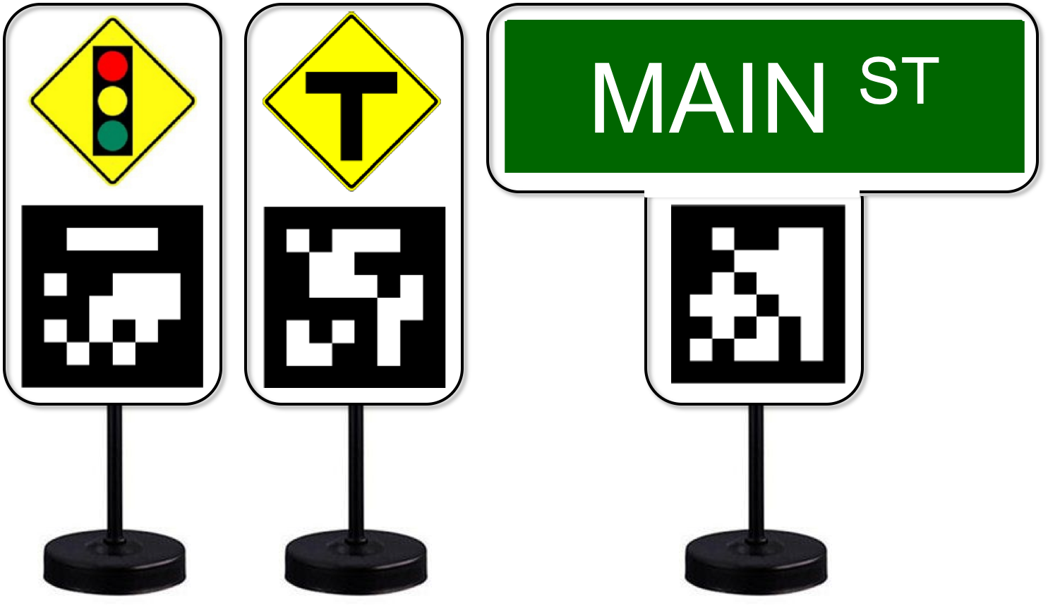
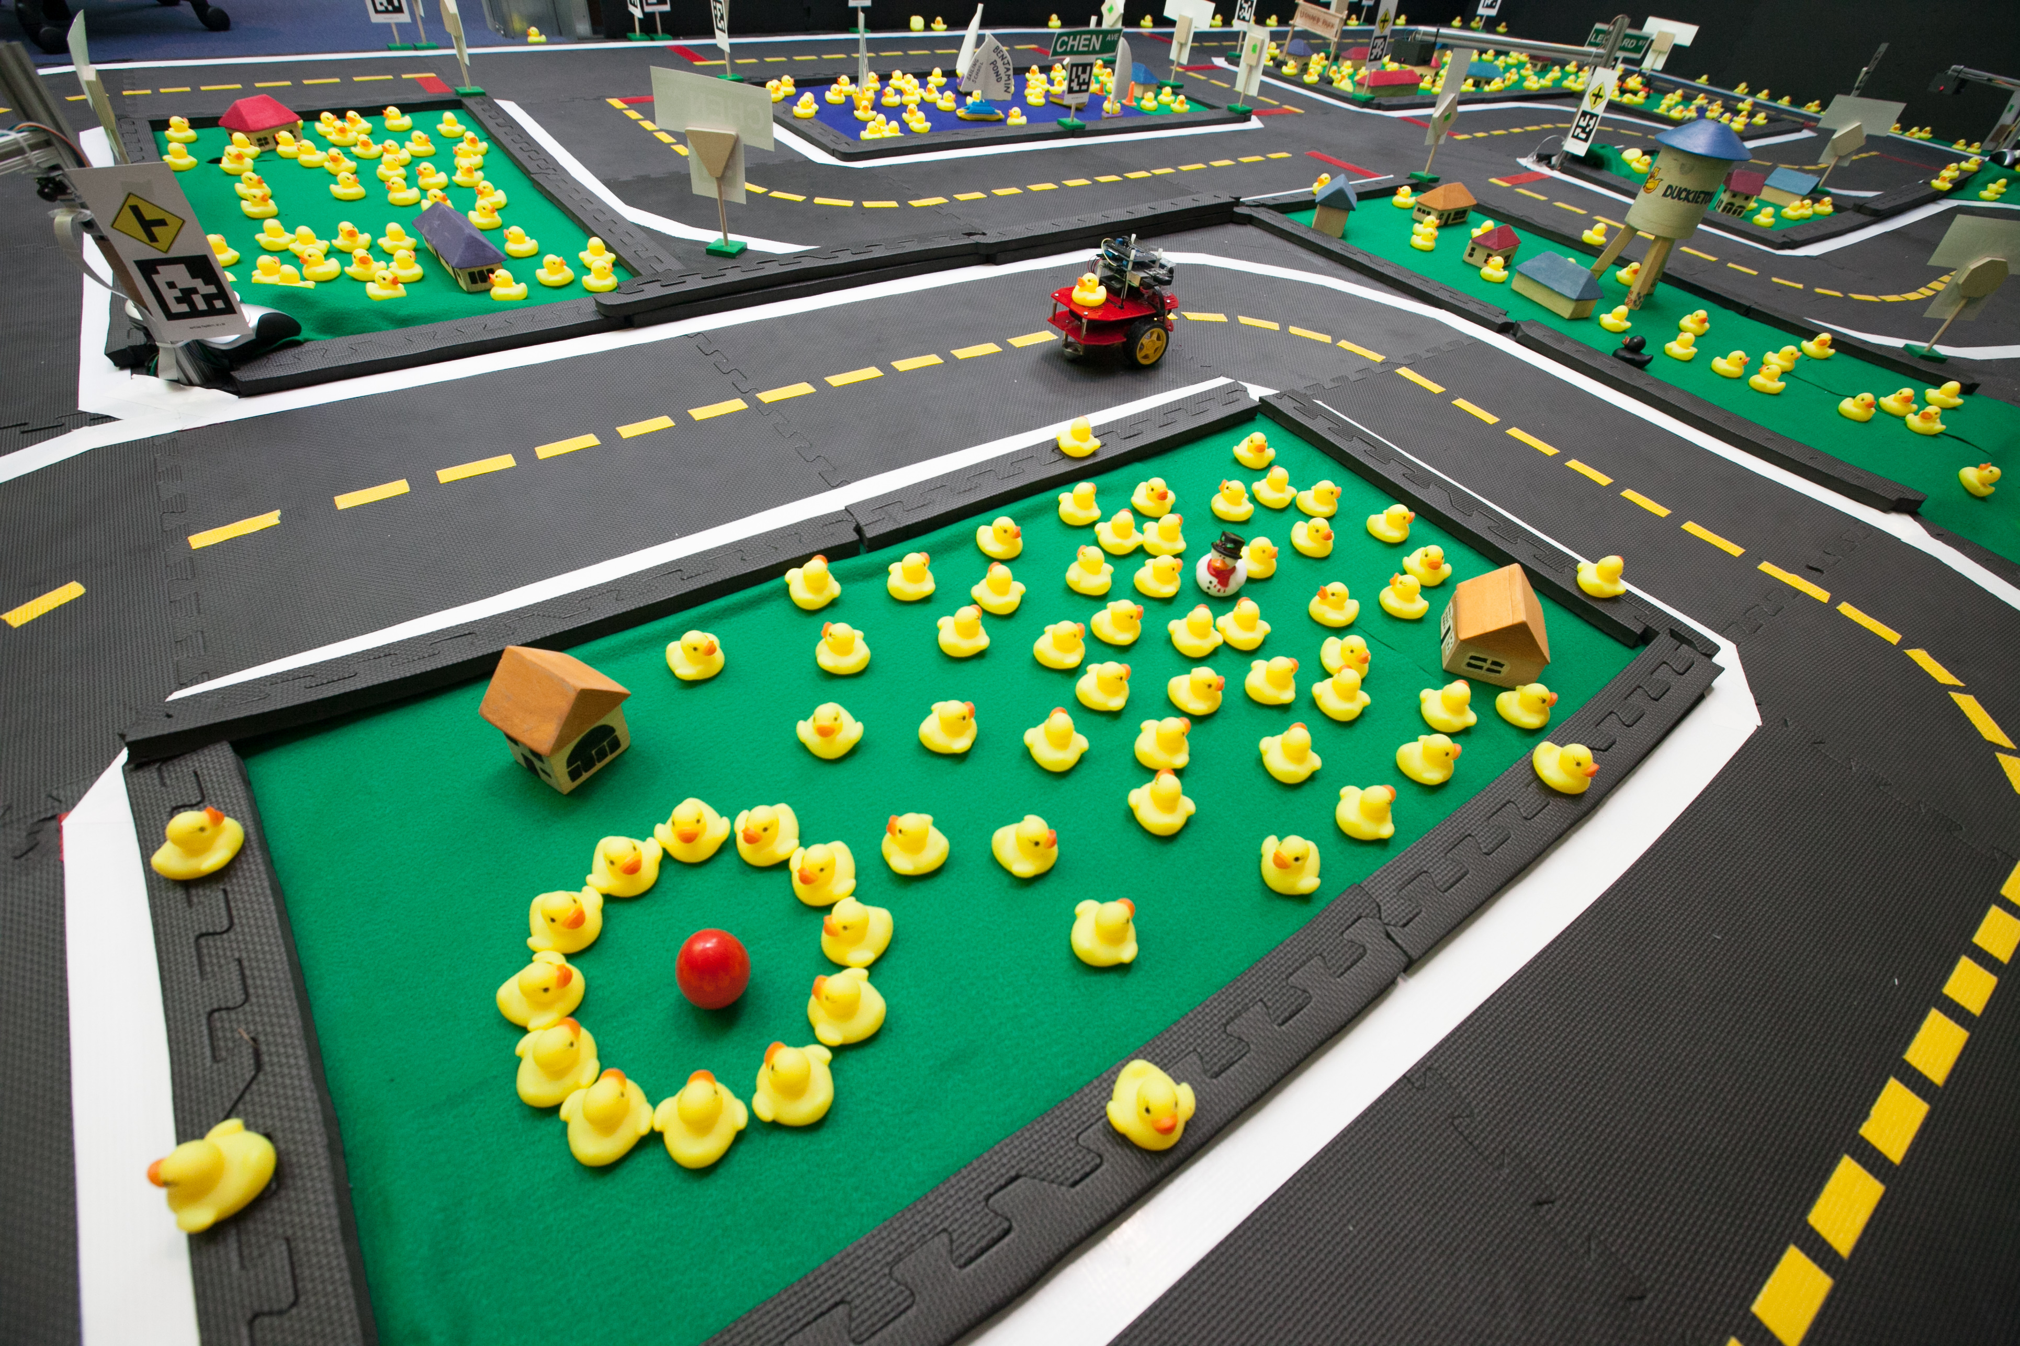
Duckietowns
Signal layer
Floor layer
(a) 3-way
(b) 4-way
Traffic lights
(c) turn
Modular and tightly specified to guarantee success
(d) straight
(e) empty
Road signs
Just add Duckies! →

Slide 3

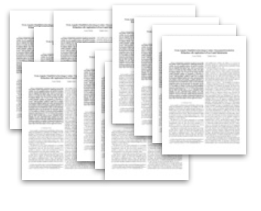

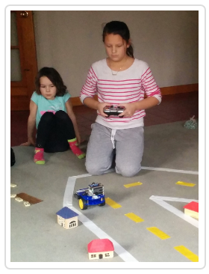
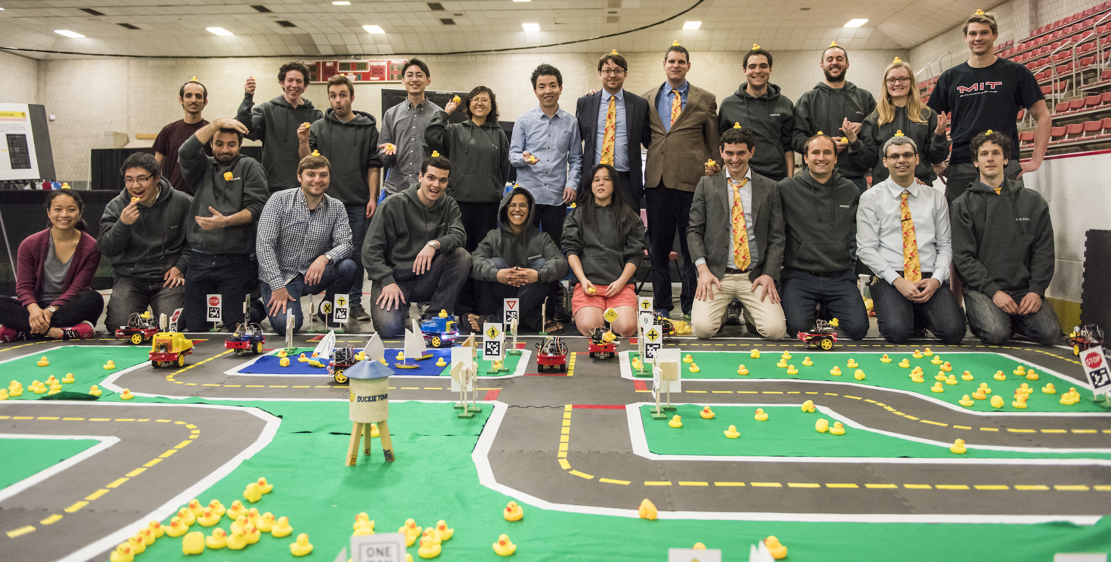

Duckietown is…
An advanced autonomy class taught at MIT in 2016 | A role play exercise | A research project
An open source and reproducible learning experience | An outreach effort | A lot of fun!
Peer institutions
Other institutions
Independent learners

Slide 4
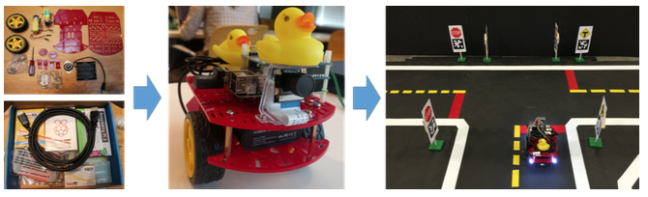
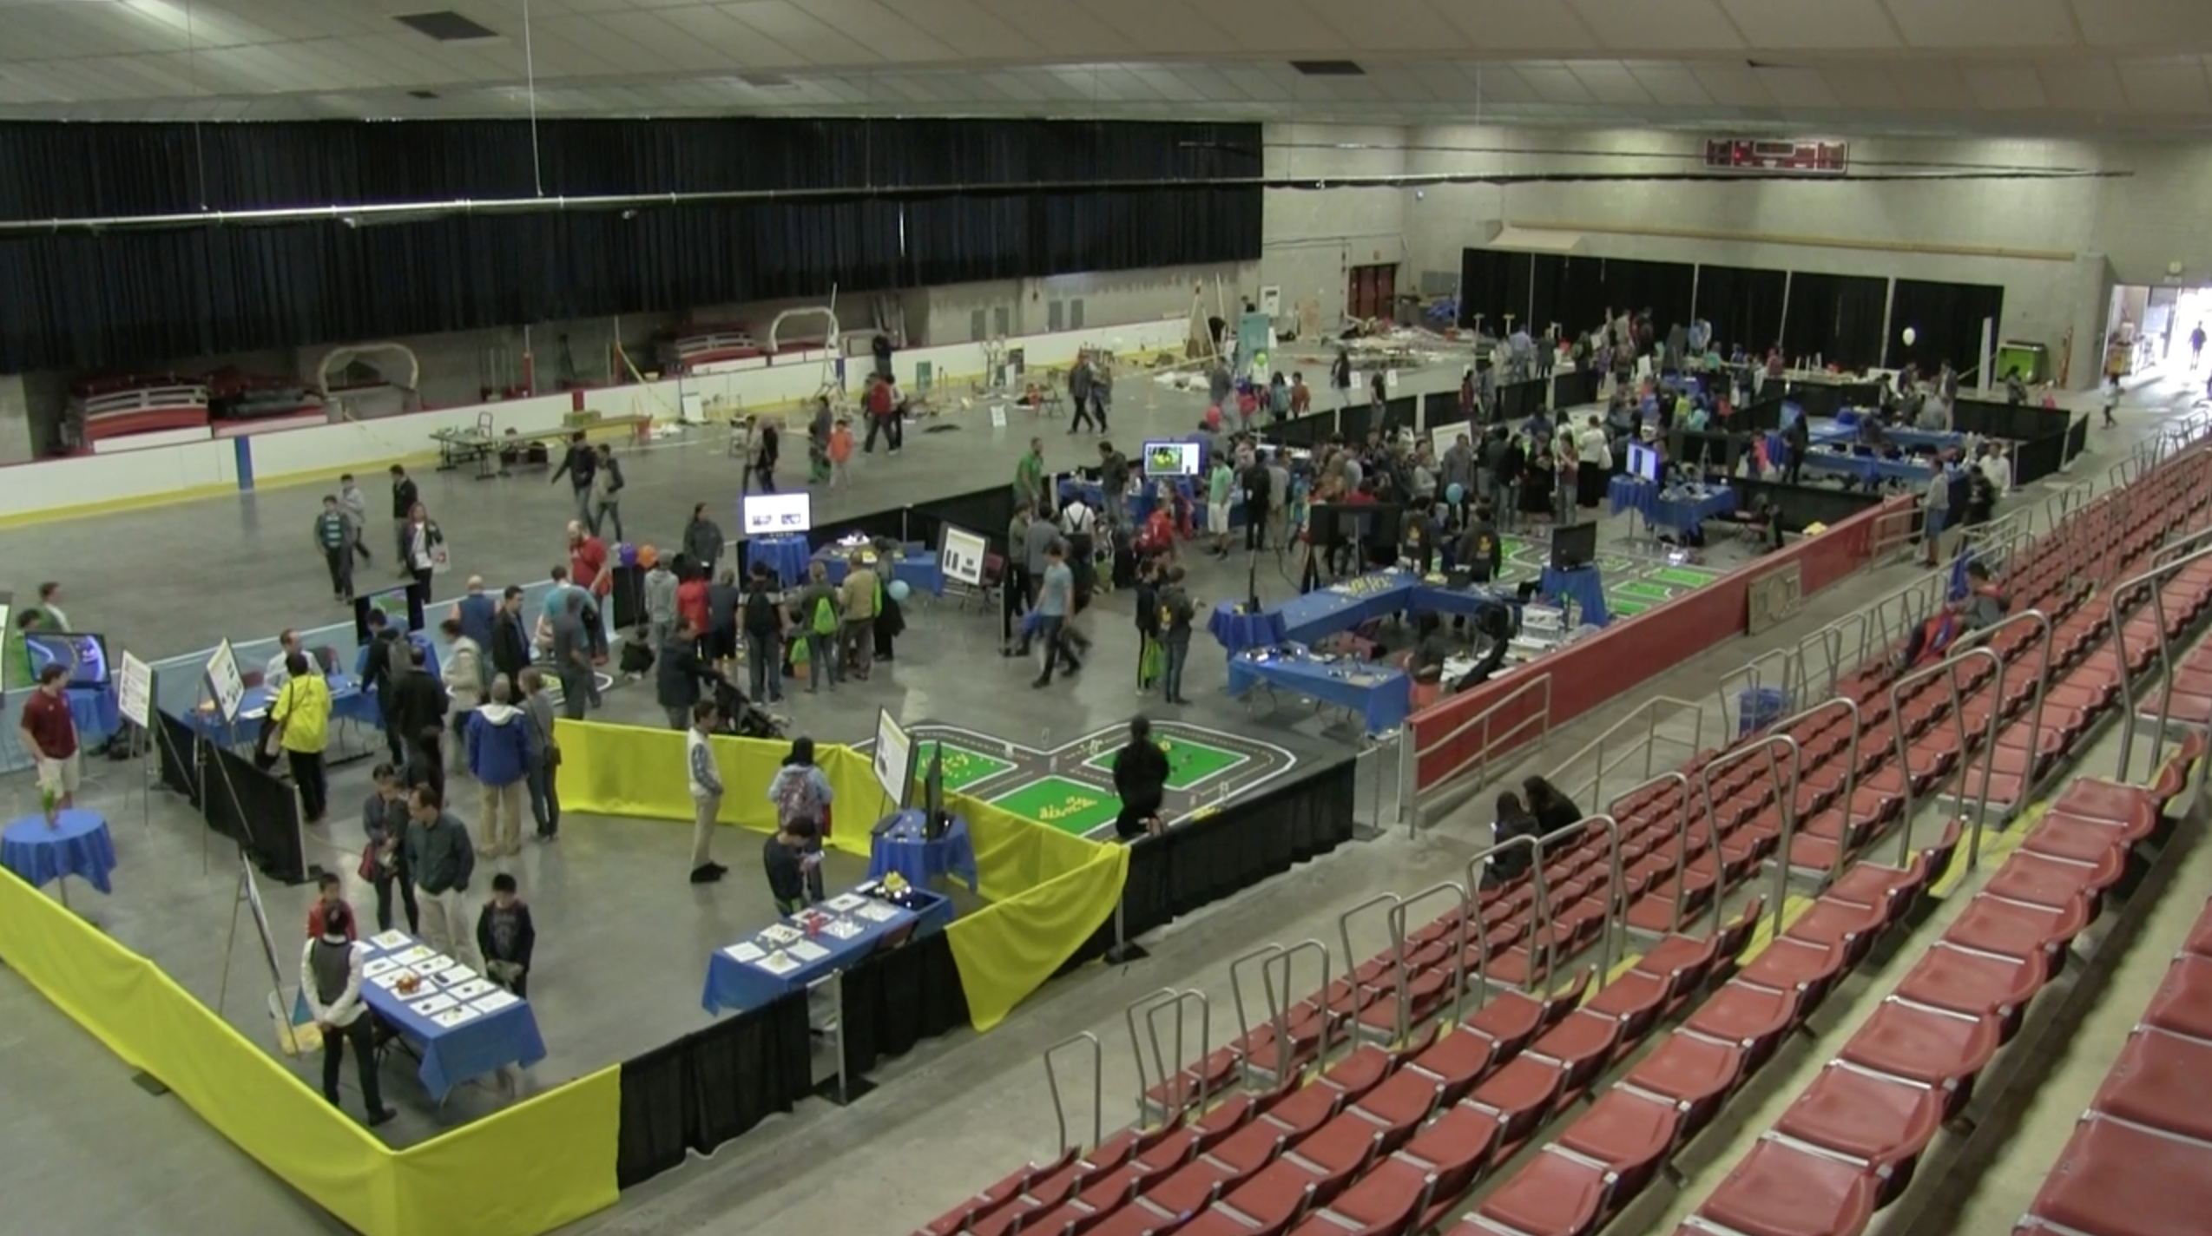
Phase 1: Autonomy Tutorial
Phase 2: Team Projects
Phase 3: Public Demonstration

